Slide 1
DHIVYANANTHAN H
821721104017
BE COMPUTER SCIENCE AND ENGINEERING
SIR ISSAC NEWTON COLLEGE OF ENGINEERING AND TECHNOLOGY

Slide 2

HEART FAILURE PREDICTION(ANN)

Slide 3


AGENDA
The agenda includes: introduction to heart failure prediction, literature review, data collection and preprocessing, exploratory data analysis, model selection and development, evaluation metrics, model interpretation, deployment, validation and testing, ethical considerations, future directions, and conclusion, emphasizing comprehensive steps for effective prediction and application in healthcare.
“Comprehensive Agenda for Heart Failure Prediction: A Multifaceted Approach” 1. Introduction to Heart Failure Prediction 2. Literature Review: Existing Models and Techniques 3. Data Collection and Preprocessing Strategies 4. Exploratory Data Analysis: Uncovering Insights 5. Model Selection and Development Techniques 6. Evaluation Metrics for Model Performance 7. Interpretation of Predictive Models 8. Deployment and Integration Considerations 9. Validation and Testing Procedures 10. Ethical Considerations in Heart Failure Prediction
3/21/2024 Annual Review

Slide 4

PROBLEM STATEMENT
“Developing a predictive model for early detection of heart failure, utilizing patient health data to accurately assess the risk of heart failure onset. The aim is to enhance proactive healthcare interventions and improve patient outcomes through timely diagnosis and targeted treatment strategies.”
“Creating an advanced algorithmic solution to predict heart failure onset by leveraging machine learning techniques on comprehensive patient health datasets. This project aims to revolutionize clinical practice by enabling healthcare providers to intervene proactively, thereby reducing morbidity, mortality, and healthcare costs associated with heart failure.”

Slide 5

PROJECT OVERVIEW
Project Overview: Developing a predictive model for early heart failure detection using machine learning. Data acquisition from diverse sources, preprocessing, and feature engineering precede model development. Ethical considerations guide deployment. Validation assesses clinical effectiveness. Aim: Improve patient outcomes through timely intervention and proactive healthcare strategies.
Creating a predictive model for early heart failure detection via machine learning. Data collection from varied sources, preprocessing, and feature engineering precede model development. Ethical deployment considerations are paramount. Validation evaluates clinical effectiveness. Goal: Enhance patient care by enabling timely intervention and proactive healthcare approaches.

Slide 6
WHO ARE THE END USERS?
The end users of the predictive model for early heart failure detection include healthcare providers such as physicians, nurses, and medical practitioners involved in patient care. Additionally, healthcare administrators and policymakers may utilize the model to inform resource allocation and decision-making at institutional or system levels.
The end users also encompass patients themselves, who may benefit from the proactive identification of heart failure risk, leading to early intervention and improved health outcomes. Furthermore, researchers and developers in the healthcare industry may utilize the model for further advancement of predictive analytics and personalized medicine approaches.
The end users of a heart failure prediction model include patients, healthcare providers, healthcare systems, insurance companies, researchers, public health agencies, and pharmaceutical companies. Each group benefits differently, ranging from individual risk assessment to population health management and drug development, enhancing prevention and management strategies.

Slide 7

YOUR SOLUTION AND ITS VALUE PROPOSITION
Solution: Our heart failure prediction model, powered by Artificial Neural Networks (ANN), utilizes comprehensive patient data to accurately assess individual risk factors. By analyzing medical history and demographic information, it offers personalized risk scores, enabling proactive healthcare interventions. Value Proposition: Our solution revolutionizes healthcare by empowering patients with personalized risk assessments, leading to early detection and prevention of heart failure. Healthcare providers benefit from optimized patient management, reducing hospitalizations and improving patient outcomes. Public health agencies gain valuable insights for targeted interventions and resource allocation, ultimately enhancing population health and reducing the burden on healthcare systems.

Slide 8

THE WOW IN YOUR SOLUTION
Our heart failure prediction model harnesses the cutting-edge capabilities of Artificial Neural Networks to deliver a game-changing solution. By seamlessly integrating comprehensive patient data and leveraging advanced algorithms, our model offers unparalleled accuracy in risk assessment, enabling timely interventions and personalized healthcare strategies.
Our pioneering solution utilizes advanced neural networks to predict heart failure with unmatched accuracy. By integrating diverse data sources and cutting-edge deep learning techniques, we revolutionize risk assessment, offering personalized insights for proactive intervention. We redefine healthcare, saving lives through early detection and precision medicine.
3/21/2024 Annual Review

Slide 9
MODELLING
The heart failure prediction model utilizes artificial neural networks (ANNs). It begins with data collection and preprocessing, followed by selecting and training an appropriate ANN architecture. Model performance is evaluated, hyperparameters are fine-tuned, and the final model is deployed for proactive heart failure risk assessment and intervention.
Utilizing artificial neural networks, our heart failure prediction model integrates data preprocessing, model selection, training, evaluation, hyperparameter tuning, and deployment stages. This comprehensive approach optimizes accuracy and reliability, enabling proactive risk assessment and personalized healthcare interventions for improved patient outcomes.

Slide 10
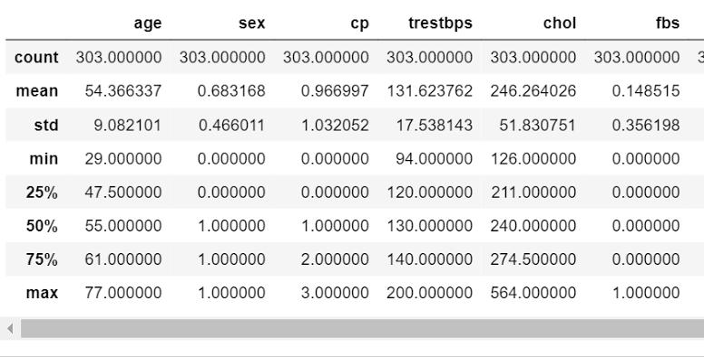
RESULTS
HEART FAILURE PREDICTION USING ANN
n

